Slide 1
Presentation team Geodan
DB Hackathon 2015

Slide 2
Who?
Geodan http://www.geodan.nl
Tim Ebben (research department) tim.ebben@geodan.nl
Bert Temme (research department)
bert.temme@geodan.nl

Slide 3
What?
Incident Management Application for Control Room
Features:
Intake incident
Visualize incident in map
Analyse incident
Notificate people

Slide 4
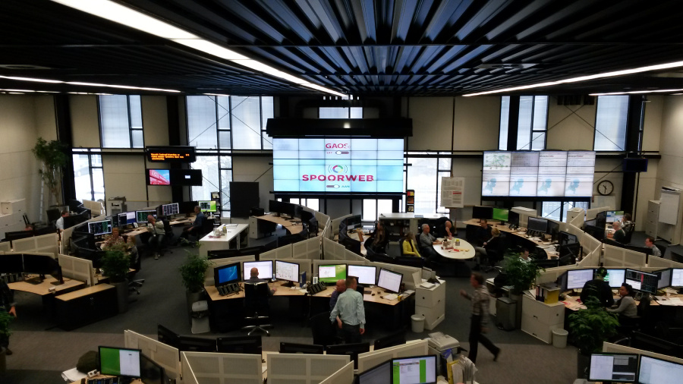
ProRail SpoorWeb
More info: http://www.geodan.com/solutions/incident-management-system-prorail/

Slide 5
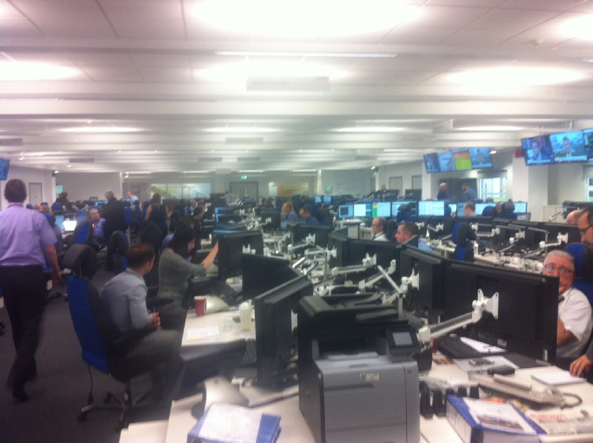
Spoorweb at Rail Operating Centre (ROC) in York

Slide 6
Why?
Fix incidents more quick
Give people correct information what/where/when
Less delays -> reduce costs

Slide 7
How?
Create and fill database
Create DB Bahn REST API (JSON)
Create DBBahn mapservice
Create Incident Control Room application (desktop)

Slide 8
Data used
Bahnstrecken
Kilometerpoints
Tunnels
Data processing: Shape -> PostGIS

Slide 9
Architecture
Javascript
Android
IOS
Desktop
HTTP Request
JSON Response
OpenStreetMap
DB Bahn services
Geoserver
SMS service
Geocoder
Pinpoint
SQL
PostgreSQL (DB Bahn)

Slide 10
Techniques
Database: PostgreSQL + PostGIS
Webservices: ASP.NET Web API
Map: Geoserver
Desktop: WPF + Mapsui

Slide 11
Future improvements
Display more data
Extend intake form
Store incident information
Add more rules and notifications

Slide 12
Demo!
Intake incident
Visualize incident
Send SMS notifications

Slide 13
Thanks!
Tim Ebben
Tim.ebben@geodan.nl
www.twitter.com/timebben
Bert Temme
Bert.temme@geodan.nl
www.twitter.com/berttemme

